Slide 1

Wine Quality Analysis
Submitted by: Shalini Gupta
Notes:
Consider talking about:
Current
Former

Slide 2

Contents
Person Information
Domain and topic
Project Introduction
Dataset Description
Hypothesis
Approach
Visualization
Conclusion

Slide 3
Personal Introduction
Name: Shalini Gupta
Shalini is a Technical Trainer, currently working with HCL. She is having 14 years of experience.
She has enrolled for Big Data Analytics 6 months program.

Slide 4
Project Introduction
Topic: Wine quality analysis
Domain: Food and Beverages
About the Project:
  Project is all about analyzing the data of various type of wines. Based on various ingredients, need to find the features which affects the quality of wine.

Slide 5
Dataset Description
Data is available in winequality.csv file.
Using Python, let’s understand dataset.

Slide 6
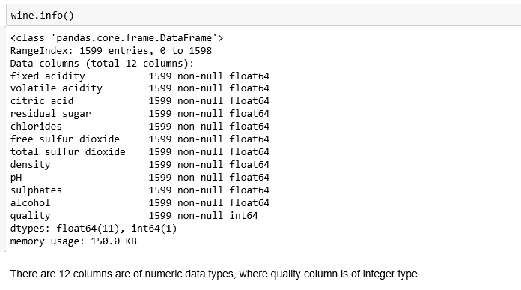
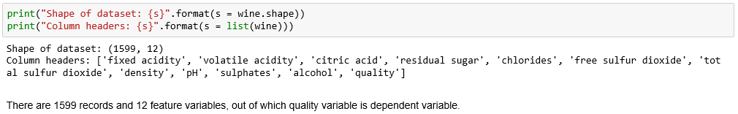
Exploring the dataset

Slide 7
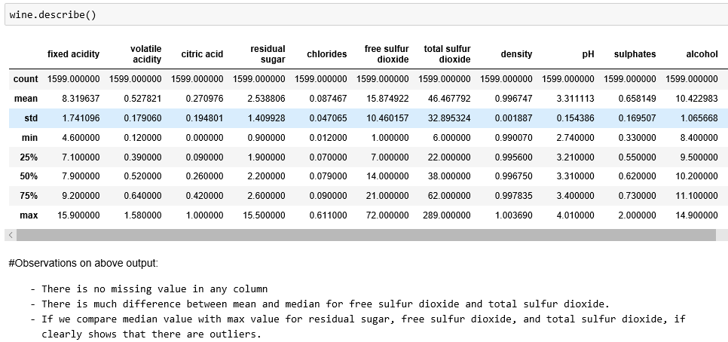

Slide 8
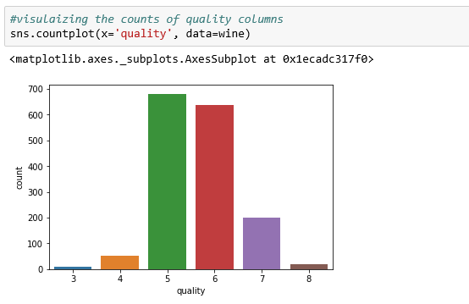
Visualizing Quality Column

Slide 9
Correlation on variables
Notes:
Consider talking about:
Current
Former

Slide 10
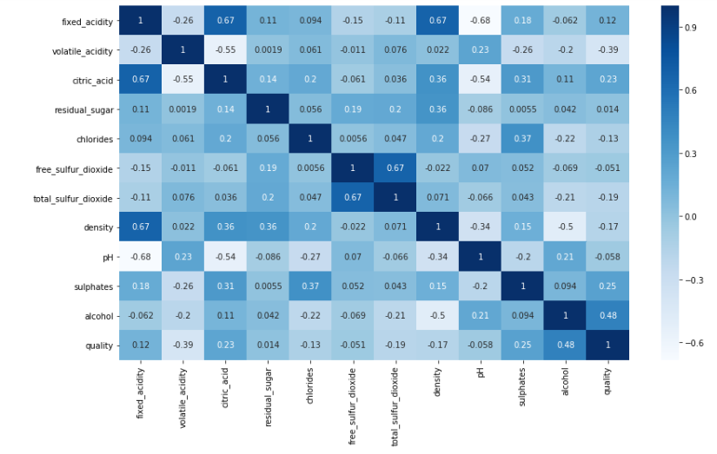

Slide 11
Observations and Hypothesis
Following are highly positively correlated independent variables with value (0.67):
  density and fixed_acidity
  total_sulfur_dioxide and free_sulfur_dioxide
  Citric_acid and fixed_acidity So, while creating any model, we can take one of the two columns
Following are correlated with quality, which helps to understand features to be considered for quality of a wine:
  alcohol - highly correlated
  volatile_acidity - least correlated
Hypothesis:
    It means alcohol, sulphates, and citric_acid have maximum correlation with quality of wine. Changes in values of these will affect the quality of wine.

Slide 12
Validating the Hypothesis
Notes:
Consider talking about:
Current
Former

Slide 13
Approach:
Added rating column to represent quality:
  Poor : 1 to 4
  Normal: 5 to 6
  Good: 7 to 10
Created univariate and multivariate visualizations for residual sugar, alcohol, density, and quality.
Created a boxplot, to visualize the outliers in the data.
After that using the imputation method, replaced the outliers with median. To find the outliers while imputation, we have used quantiles.
After replacing the outliers, we again plot graphs on almost every variable based univariate and bivariate.

Slide 14
Visualizations
Notes:
Consider talking about:
Current
Former

Slide 15
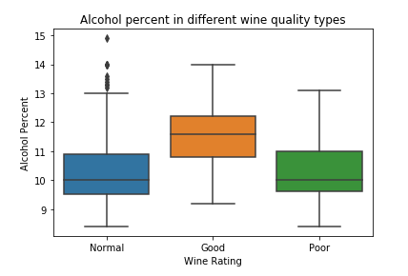
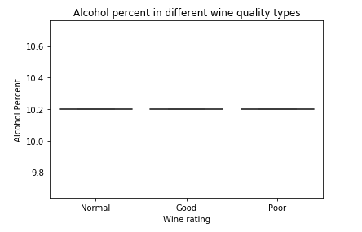
Alcohol Before Outlier treatment
Alcohol After Outlier treatment
Observation:
Alcohol does not affect the quality of wine, Almost every type of wine has similar amount of alcohol.

Slide 16
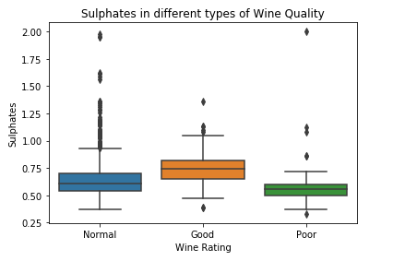
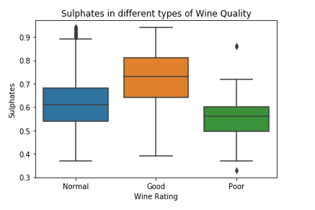
Sulphates Before Outlier treatment
Sulphates After Outlier treatment
Observation:
Sulphates affects the quality of wine. More the sulphate will make quality good.

Slide 17
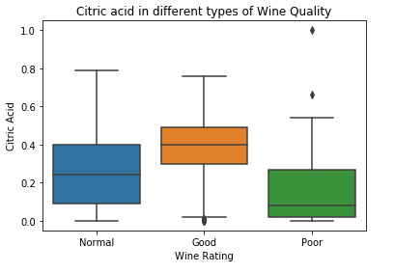
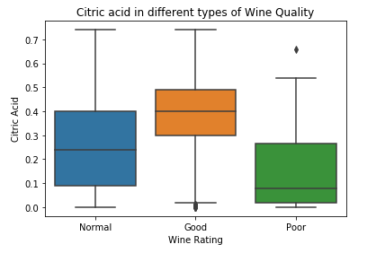
Citric Acid Before Outlier treatment
Citric Acid After Outlier treatment
Observation:
Citric acid affects the quality of wine. More the it, will make quality good.

Slide 18
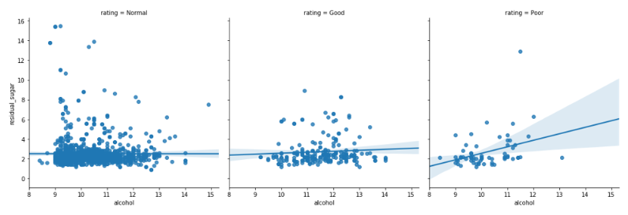
Residual Sugar and alcohol with Quality Before Outlier treatment

Slide 19
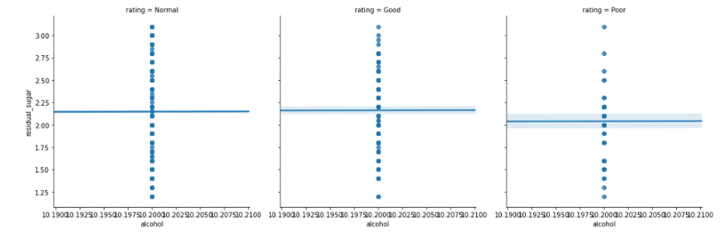
Residual Sugar and alcohol with Quality After Outlier treatment
Observation:
It clearly shows that residual sugar affects the quality, however, alcohol does not.

Slide 20
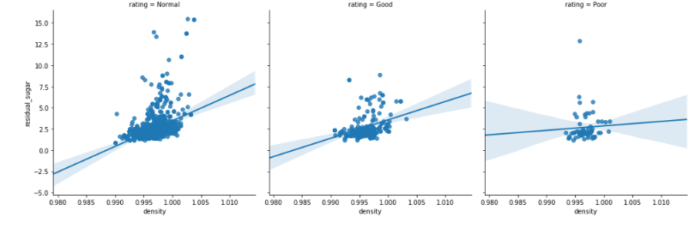
Residual Sugar and density with Quality Before Outlier treatment

Slide 21
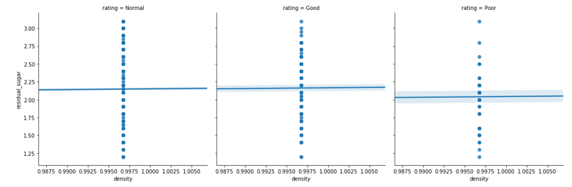
Residual Sugar and density with Quality After Outlier treatment
Observation:
It clearly shows that residual sugar affects the quality, however, density does not.

Slide 22
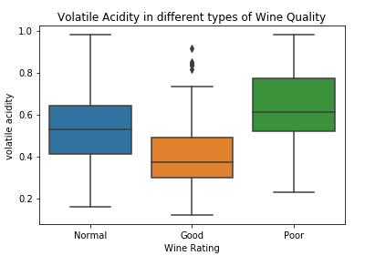
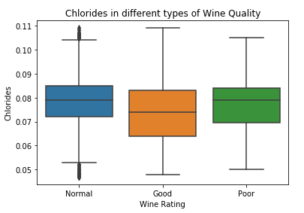
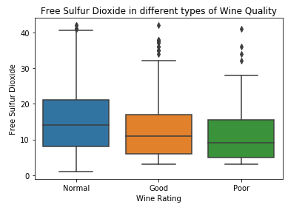
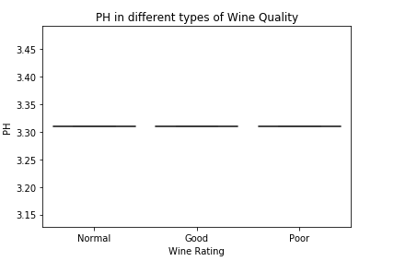
Other Variables Visualization:

Slide 23
Conclusions:
Features affecting wine negatively:
Decrease in sulphates,residual sugar and citric acid will reduce the wine quality.
Increase in chlorides and volatile acidity will aslo reduce the wine quality.
Almost no effect on wine quality:
Alocohol, density and pH do not effect the quality of wine.

Slide 24

Thank You!

